Slide 1
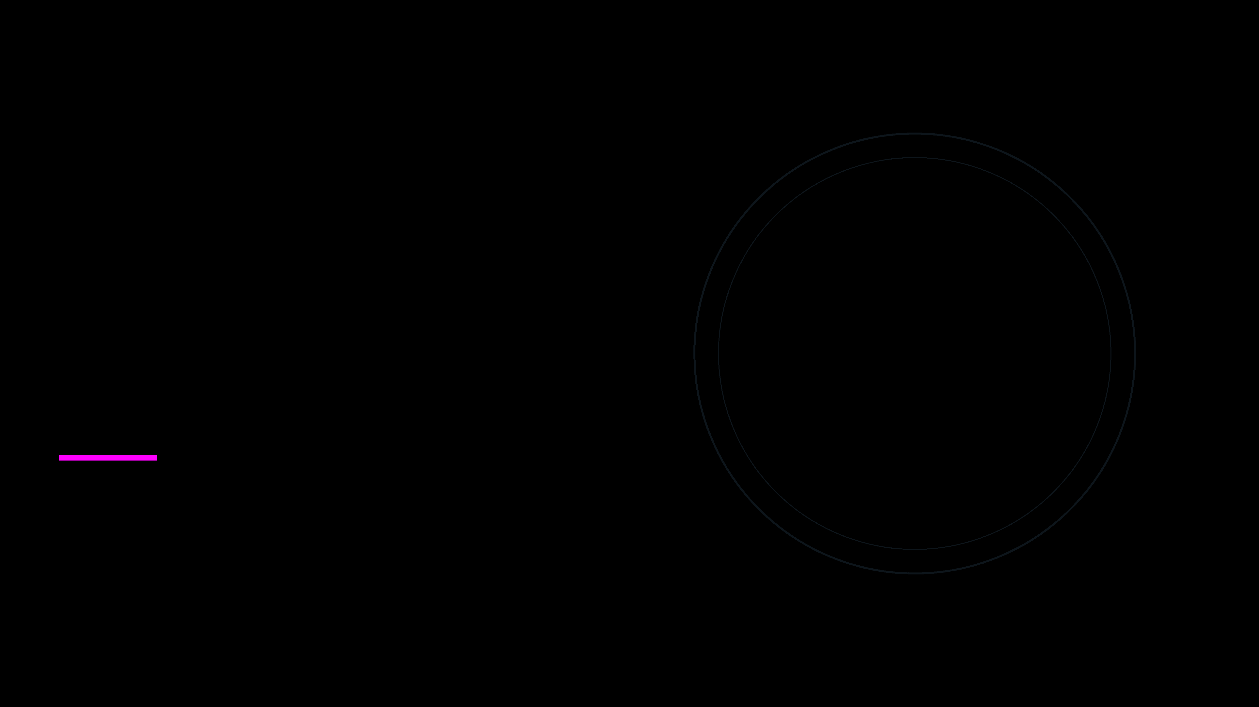
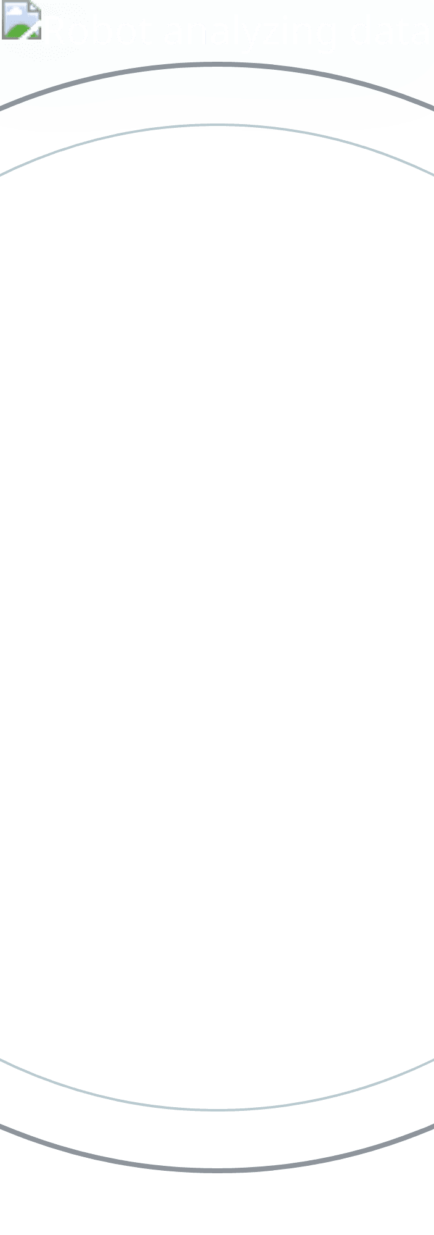
Module 07
Model Evaluation
Beyond Accuracy: Measuring What Matters

Slide 2
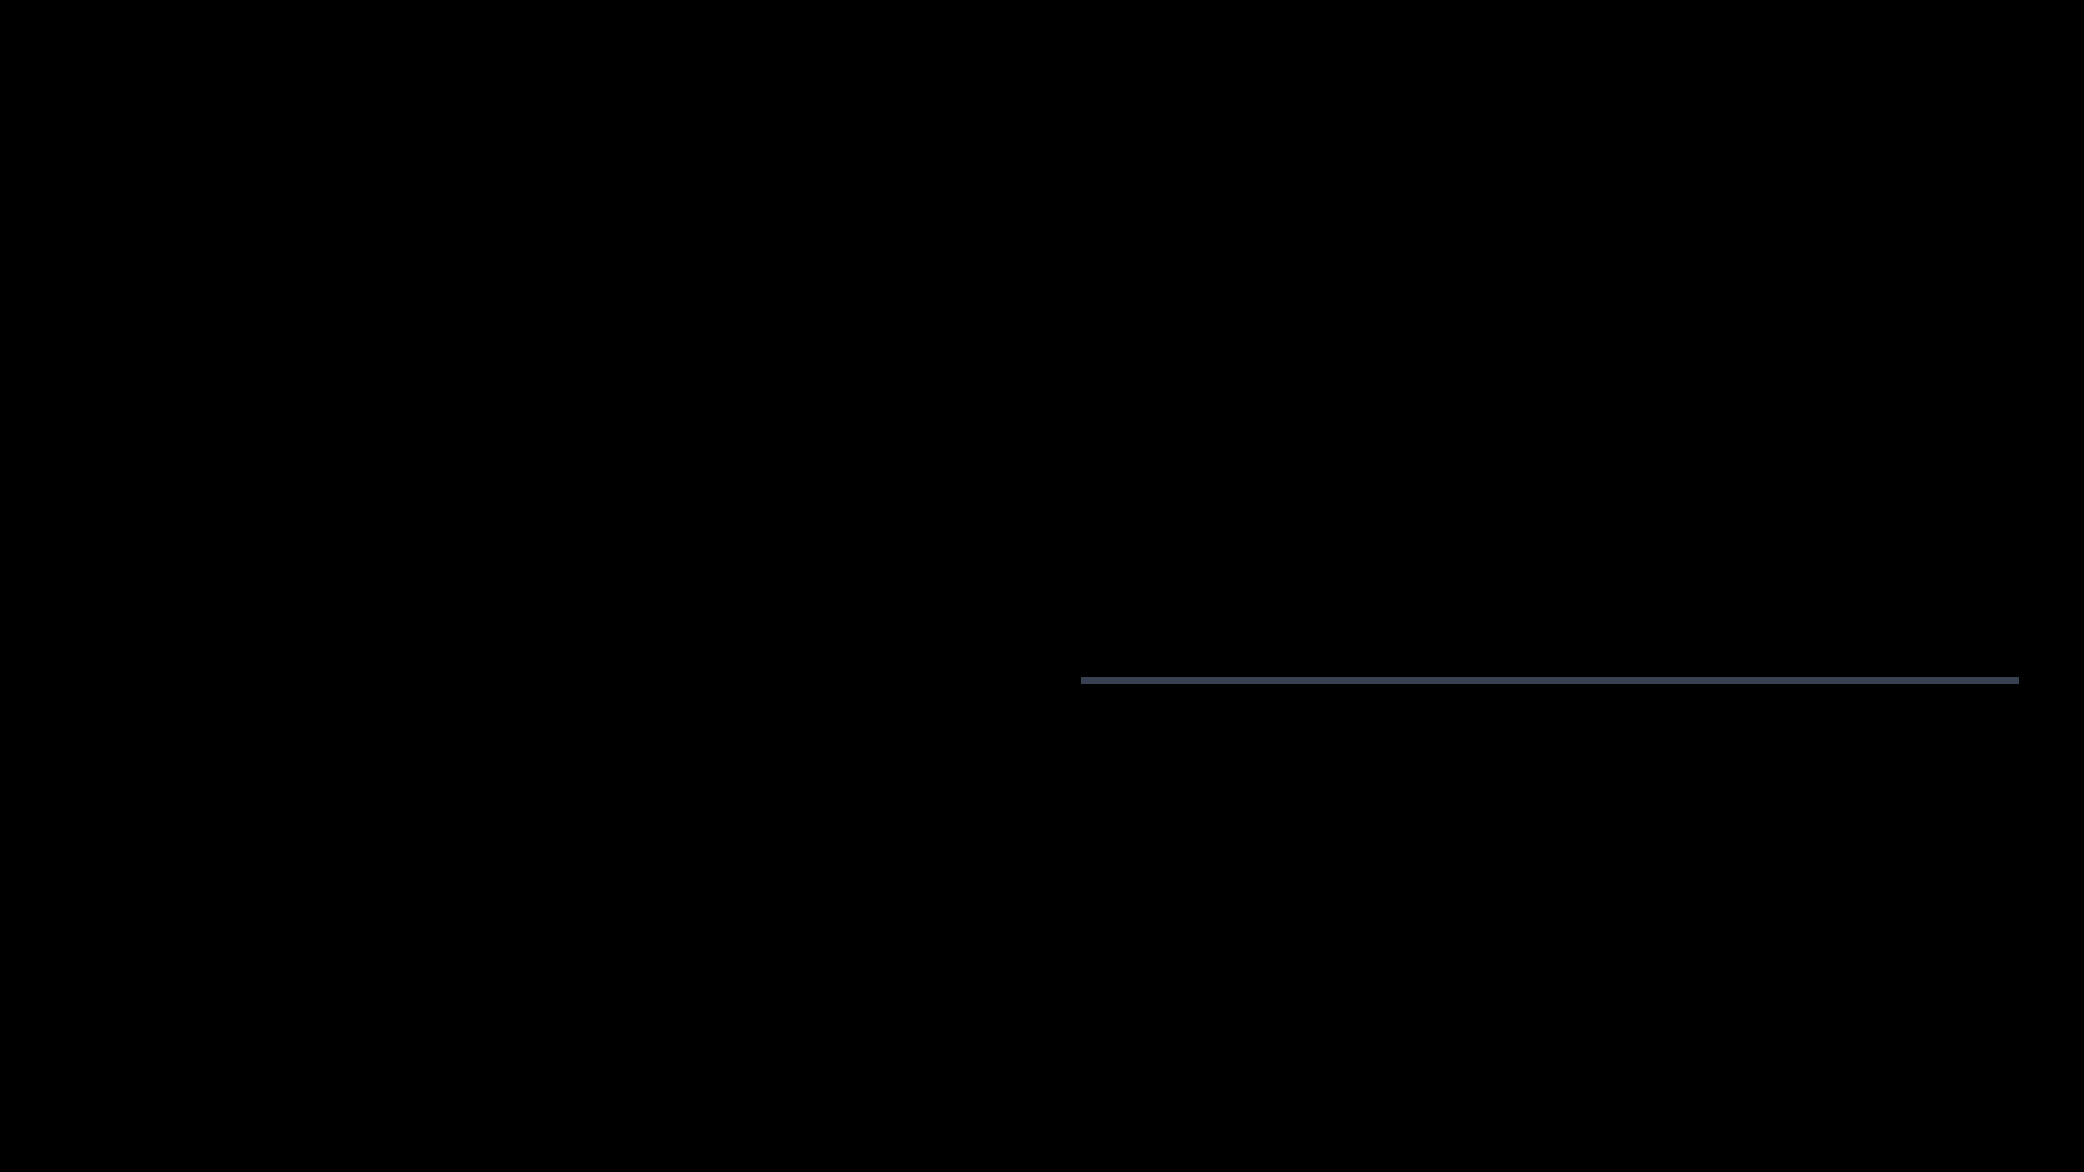
The Accuracy Lie
When 99% is a failing grade.
99.9%
The Scenario: Fraud Detection
Accuracy
Total Transactions:
1,000
Legitimate:
999
Fraudulent:
1
0%
I built a "Lazy Model" that simply predicts "Legitimate" for absolutely everyone.
Fraud Caught
Useless Model.

Slide 3

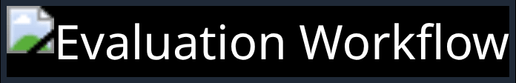
The Evaluation Toolkit
Different problems require different rulers.
Classification Metrics
Accuracy
Precision
Recall
F1-Score
ROC / AUC
Log Loss
Regression Metrics
MAE
MSE
RMSE
R-Squared

Slide 4
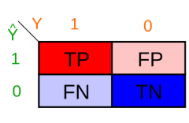
The Confusion Matrix
It's not actually confusing.
PREDICTED CLASS
Correct
Type II Error
TP
FN
True Positive
False Negative
Type I Error
Correct
FP
TN
False Positive
True Negative

Slide 5
Reading the Matrix
Decoding the Quadrants
True Positive (TP)
False Positive (FP)
We predicted YES, and it actually was YES.
We predicted YES, but it actually was NO.
"The fire alarm rang, and there was a fire."
"The fire alarm rang, but it was just toast." (False Alarm)
False Negative (FN)
True Negative (TN)
We predicted NO, but it actually was YES.
We predicted NO, and it actually was NO.
"The house burned down, but the alarm stayed silent." (Miss)
"Silence. No fire, no alarm. All good."

Slide 6
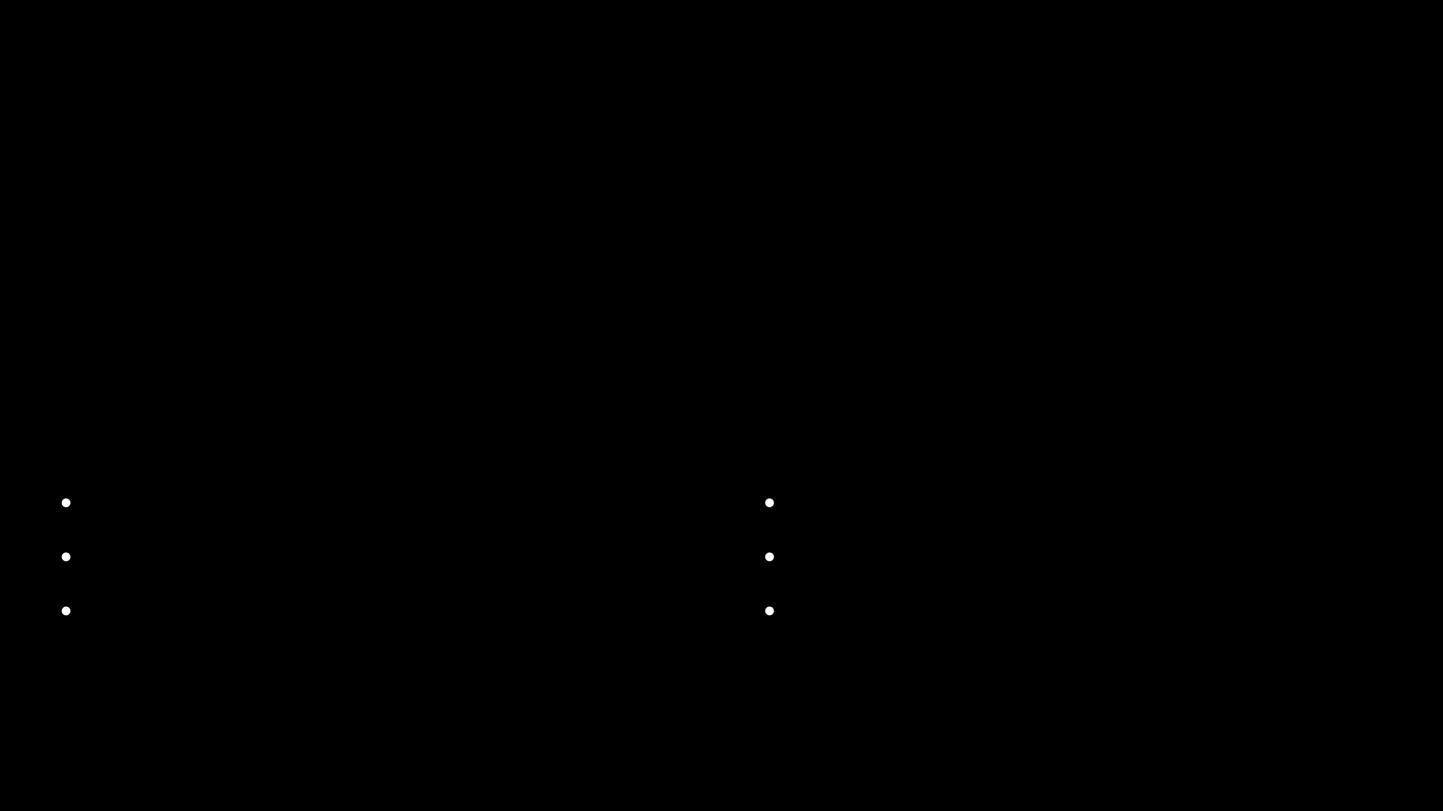
Accuracy
The most intuitive (and dangerous) metric.
Accuracy = Correct Predictions / Total Predictions
When to Use
When to AVOID
✓
Classes are balanced (50/50).
⚠
Imbalanced Data (99% vs 1%).
✓
All errors cost the same.
⚠
Fraud Detection.
✓
General overview needed.
⚠
Cancer Diagnosis.

Slide 7
Precision
The "Boy Who Cried Wolf" Metric
"Of all the times we predicted YES, how often were we actually RIGHT?"
Example: Spam Filter
False Positive: A legitimate email from your boss is marked as Spam.
Focus: False Positives
We want to minimize False Alarms. We only want to predict "Yes" when we are really sure.
Cost: You miss a meeting. You get fired. High Cost!
→ We need High Precision.

Slide 8
Recall
The "Missing Child" Metric
"Of all the ACTUAL YES cases, how many did we manage to FIND?"
Example: Cancer Screening
False Negative: A sick patient is told they are healthy.
Focus: False Negatives
We want to minimize Misses. We would rather have false alarms than miss a real case.
Cost: The patient dies. Catastrophic Cost!
→ We need High Recall.

Slide 9
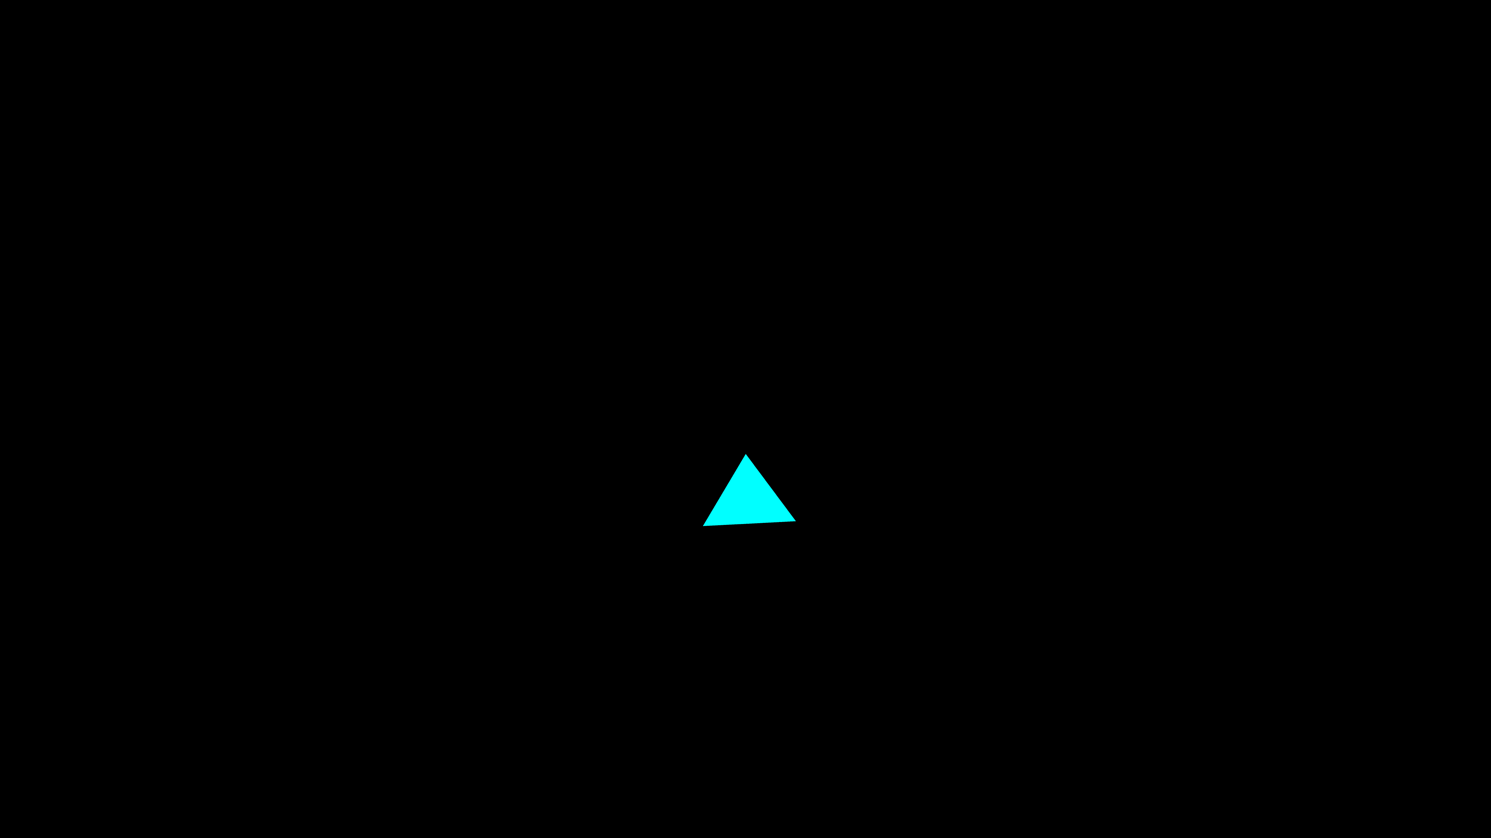
The Tradeoff
You can't have it all.
Picky Approach
Wide Net Approach
"I only guess YES if I'm 100% sure."
"I guess YES just in case."
High Precision, Low Recall
High Recall, Low Precision
Recall
Precision
"As you increase one, the other usually goes down."

Slide 10
F1 Score
The Balance Point.
F1 = Harmonic Mean of Precision and Recall
Why not just average them?
Imagine a model with 100% Precision but 0% Recall (it predicts nothing).
⚖️
Regular Average (Arithmetic Mean)
(100 + 0) / 2 = 50%
F1 Score forces the model to be good at BOTH.
Misleading! The model is useless.
Use F1 when you have uneven class distribution (imbalanced data).
F1 Score (Harmonic Mean)
2 * (100 * 0) / (100 + 0) = 0%
Honest! It tells us the model failed.

Slide 11
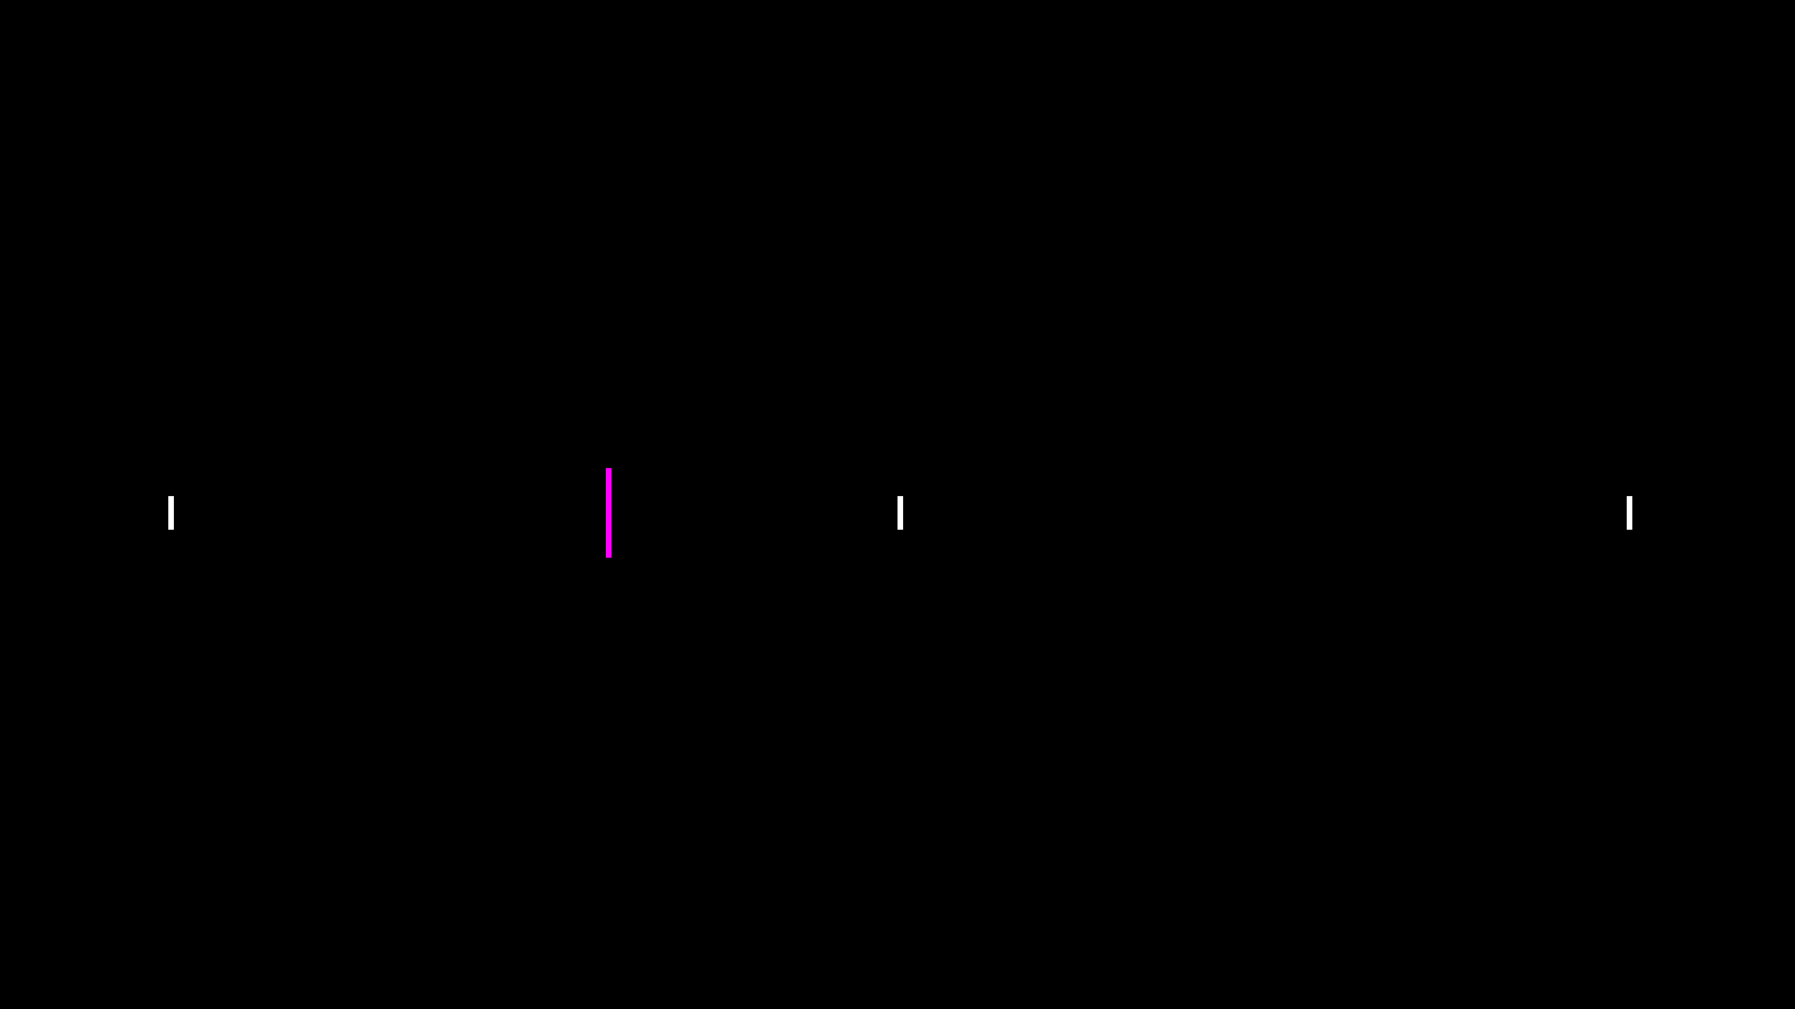
The Threshold Problem
Who decides what is "Yes"?
Models output probabilities (e.g., 0.75), not Yes/No. WE decide the cutoff.
Threshold = 0.3
NO
YES
0%
50%
100%
Low Threshold (e.g., 0.1)
High Threshold (e.g., 0.9)
"If there's even a 10% chance, flag it!"
"Only flag it if you are absolutely certain."
⬆ High Recall (Catch everything)
⬆ High Precision (Very trustworthy)
⬇ Low Precision (Lots of noise)
⬇ Low Recall (Miss subtle cases)

Slide 12
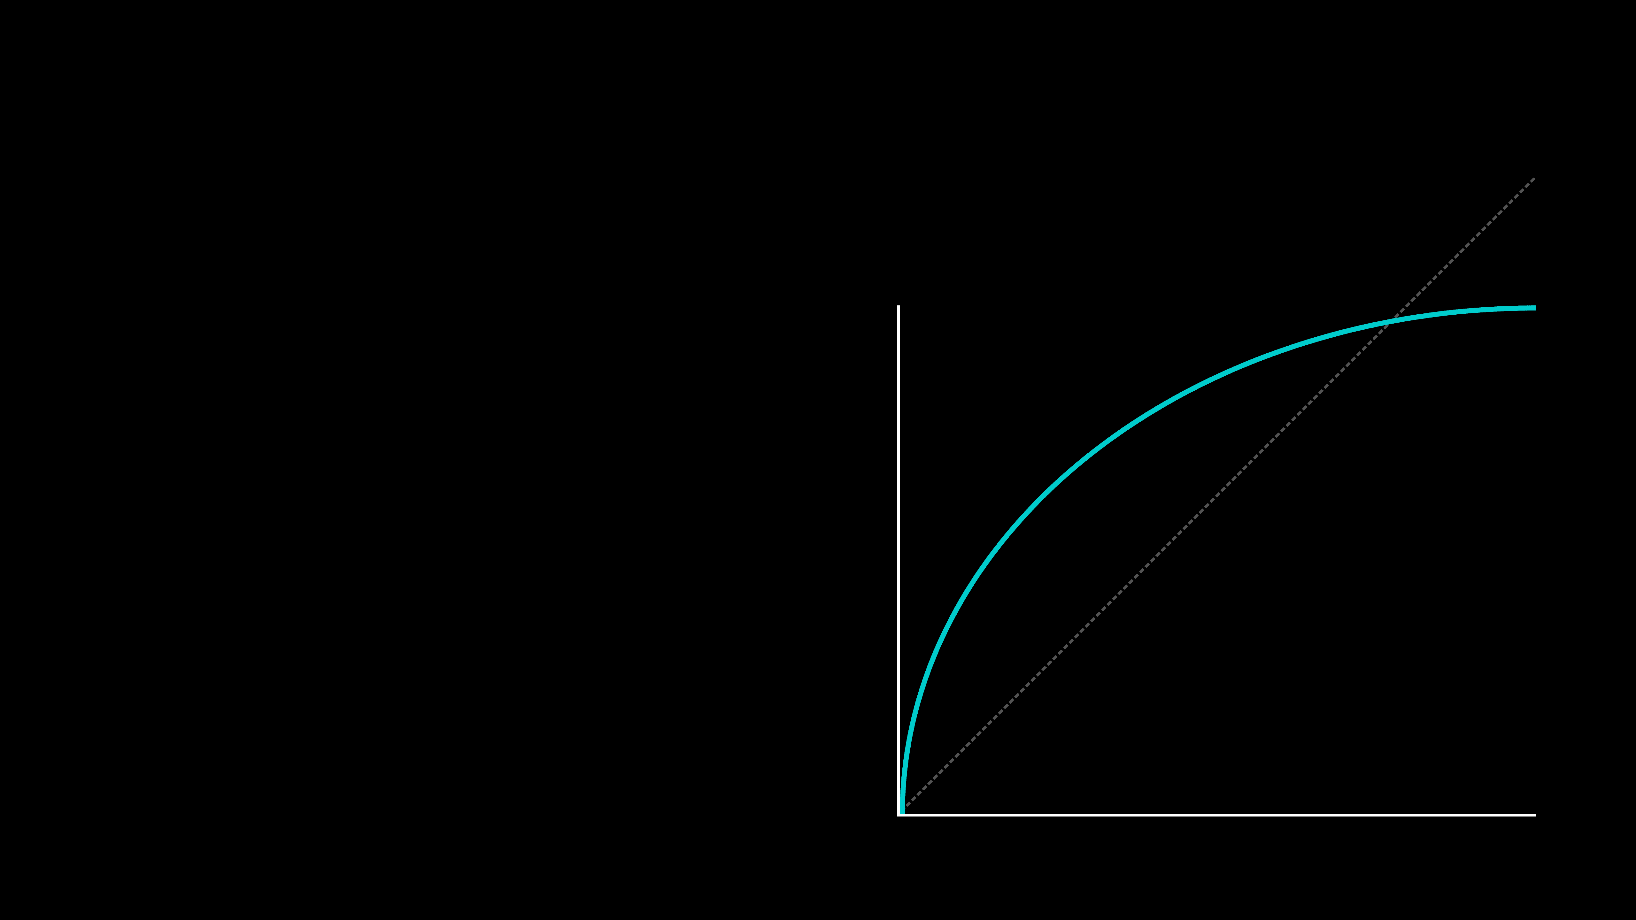
ROC Curve
What if we tried EVERY threshold?
Perfect Model
Instead of picking one cutoff (like 0.5), the ROC curve shows the performance for every possible cutoff from 0 to 1.
True Positive Rate (Recall)
Y-Axis:
True Positive Rate (Recall)
X-Axis:
False Positive Rate
"We want the curve to hug the top-left corner as tight as possible."
False Positive Rate

Slide 13
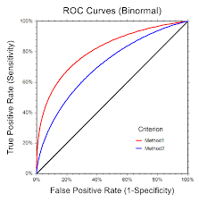
Reading the ROC
Good vs Bad Models
Rule of Thumb: The more "area" under the curve, the better the model.
Okay Model Better than guessing, but makes mistakes.
Great Model Hugs the top-left. High Recall, Low False Alarms.
Random Guessing A coin flip. Useless.

Slide 14
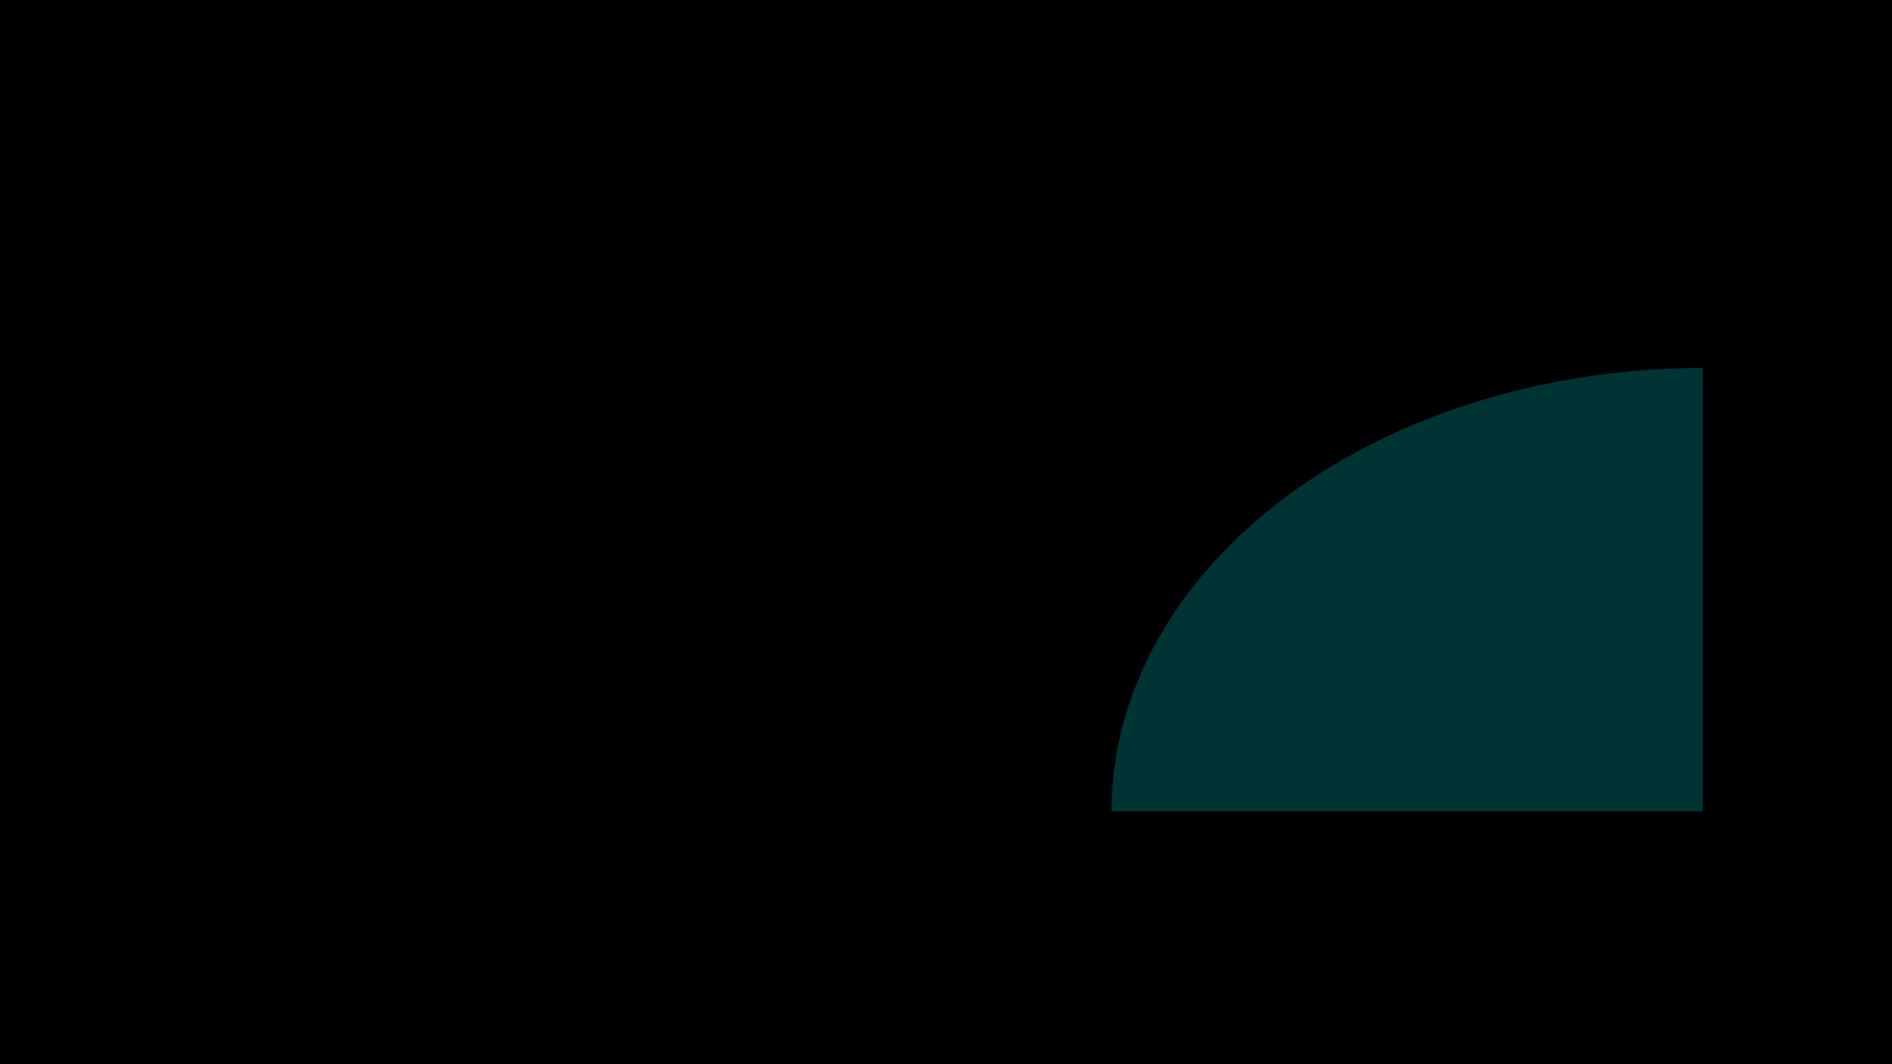
AUC Score
Area Under the Curve
ROC is a curve. AUC is a single number (0 to 1) that summarizes it.
0.9+
A
Excellent
0.85
0.7+
C
Acceptable
0.5
F
"The probability that a random Positive is ranked higher than a random Negative."
Random Guess

Slide 15
When to use ROC?
It's not always the best tool.
✅ Use ROC When...
❌ Avoid ROC When...
✓
Classes are roughly balanced.
⚠
Heavily Imbalanced
Data.
You care about both True Positives and False Positives equally.
Negatives massively outnumber Positives (e.g., 1 fraud in 10,000).
✓
⚠
✓
General model comparison.
"ROC can look 'good' (0.95) even when the model is failing to catch the minority class."
For Imbalanced Data → Use Precision-Recall Curve instead.

Slide 16
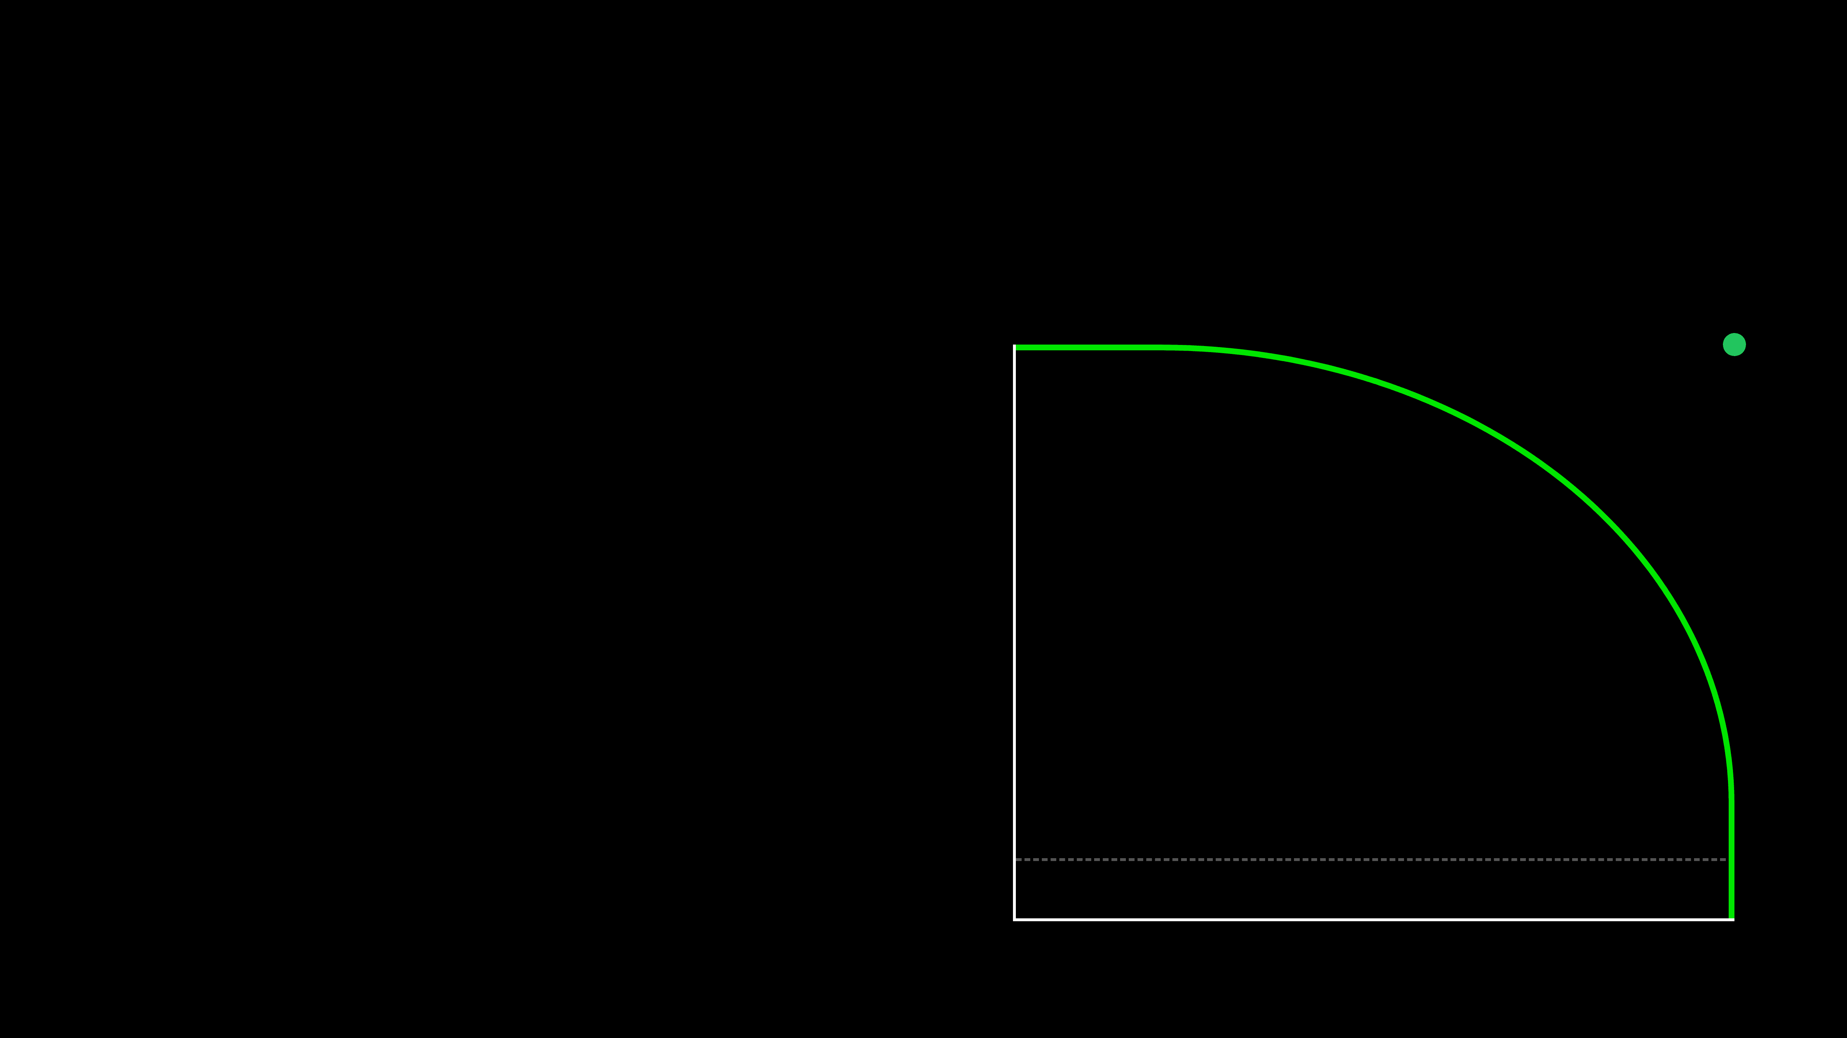
Precision-Recall Curve
The Truth Teller for Imbalanced Data.
Perfect Model
Unlike ROC, this curve ignores True Negatives. It focuses purely on the Minority Class.
Y-Axis:
Precision
Precision
X-Axis:
Recall
"We want the curve to stay high (Precision) as we move right (Recall)."
Baseline
Recall

Slide 17
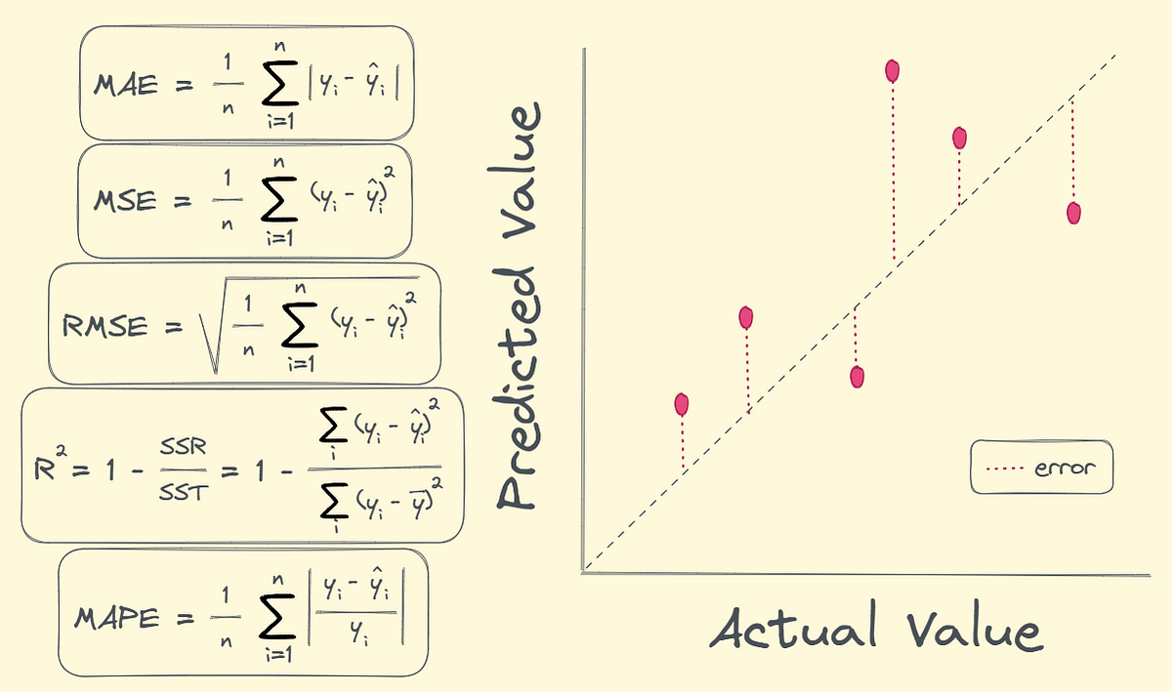
Measuring Regression Success
How wrong is our number?
MAE (Mean Absolute Error)
Large errors (Red)
"On average, our prediction is off by $5,000." Simple, intuitive, easy to explain to stakeholders.
drive RMSE up
RMSE (Root Mean Squared Error)
"Large errors are punished heavily." Use this if being very wrong is much worse than being slightly wrong.
"Are all mistakes created equal?"

Slide 18
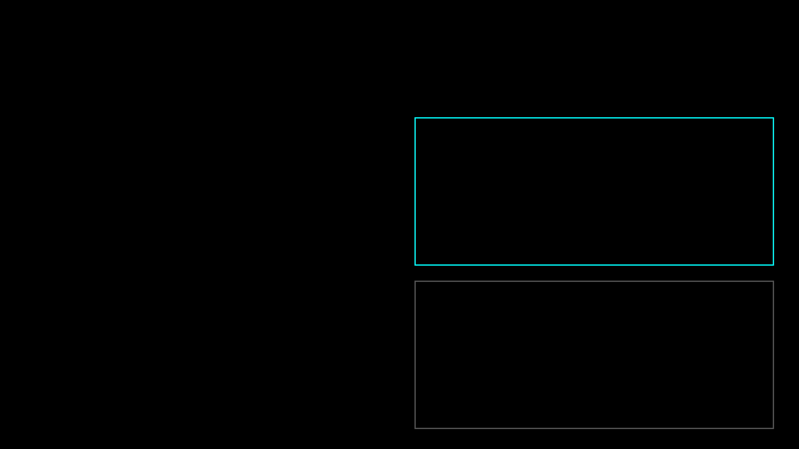
R-Squared (R²)
How much of the story does our model tell?
Good Model
Imagine variance is the "mystery" in your data.
R² = 0.85
R² = 0.80 means our model explains 80% of that mystery.
Explains most variation
The remaining 20% is still unexplained noise or missing factors.
Bad Model
R² = 1.0: Perfect prediction (Suspicious!)
R² = 0.12
R² = 0.0: Useless model (Just guessing the average)
Explains almost nothing

Slide 19
The Split Problem
Are we just lucky?
Relying on a single Train/Test split is risky.
Scenario A: "Lucky" Split (95% Accuracy)
What if your test set accidentally contains only the easiest examples?
Train
Easy Test Data
Scenario B: "Unlucky" Split (65% Accuracy)
Or the hardest ones?
Train
Hard Test Data
"It's like grading a student based on a single pop quiz. They might have just studied that one chapter."
Which accuracy is "real"? We don't know.

Slide 20
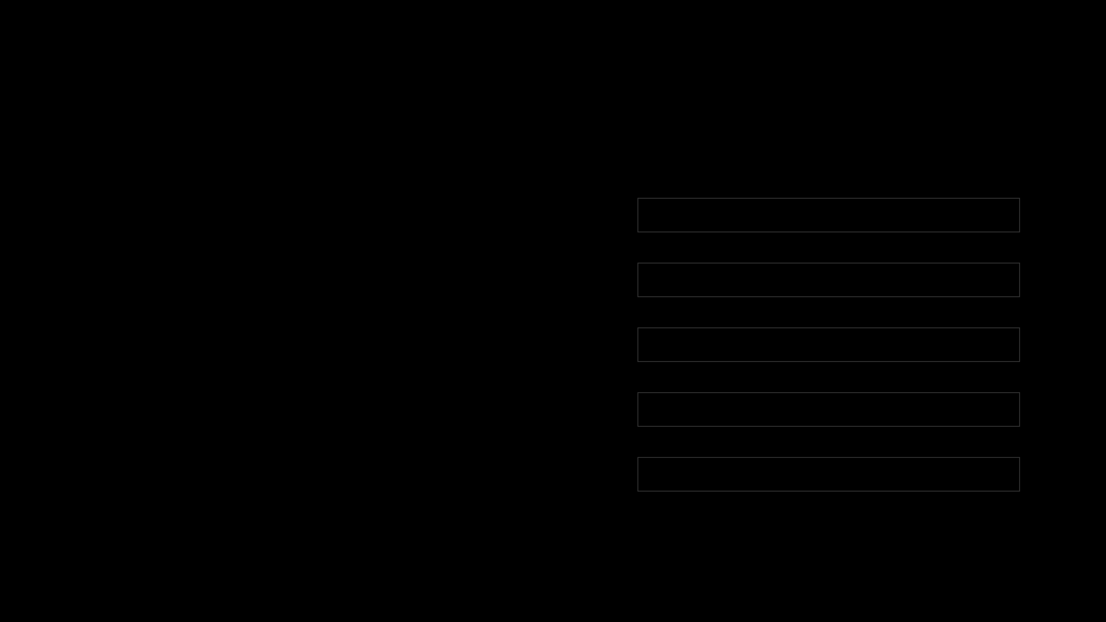
Cross-Validation
Testing on everything, just not at once.
Round 1
Test
Train
Train
Train
Train
Instead of one lucky split, we split the data into K parts (Folds).
92%
Round 2
Train
Test
Train
Train
Train
88%
1. Train on K-1 folds.
Round 3
Train
Train
Test
Train
Train
2. Test on the remaining fold.
95%
3. Repeat K times.
Round 4
Train
Train
Train
Test
Train
91%
4.
Average the scores.
Round 5
Train
Train
Train
Train
Test
93%
"It's like taking 5 different exams to prove you really know the subject."
Final Score: 91.8%

Slide 21
The K-Fold Loop
What happens inside the code?
1
Shuffle & Split
Randomly shuffle the data and divide it into K equal groups (folds).
↓
2
Iterate K Times
For each fold: Make it the Test Set. Use the other K-1 folds as the Training Set.
↓
3
Record Scores
Calculate the metric (e.g., Accuracy) for this specific split.
↓
4
Average
Report the Mean and Standard Deviation of the scores.

Slide 22
Is it worth the wait?
CV takes 5x longer. Why do it?
⚖️
1. Robustness
It proves your model isn't just "lucky." If the score is stable across 5 folds, it's a stable model.
Trust > Time
2. Data Efficiency
"You sleep better at night knowing your model works on ALL parts of the data, not just the easy ones."
Every single data point gets used for both training and testing eventually. Great for small datasets.
The Cost: Computation Time. (If training takes 1 week, maybe skip 10-fold CV!)
3. Tuning Foundation
Essential for Grid Search. You can't tune hyperparameters on just one test set (that's cheating!).

Slide 23
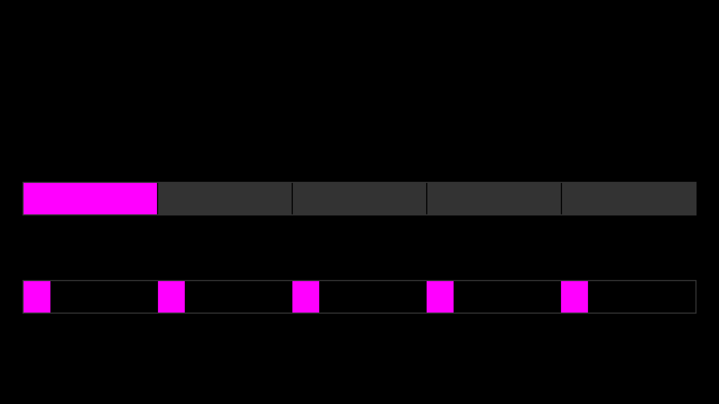
Stratified K-Fold
Keeping the balance.
What if a random split accidentally puts ALL the "Yes" cases into one fold?
Standard K-Fold (Random)
⚠ Fold 1 has 100% of the targets! The others have 0%. Model fails.
Stratified K-Fold
✓ Every fold has exactly 20% targets. Perfect balance.
Rule: Always use Stratified K-Fold for Classification.

Slide 24
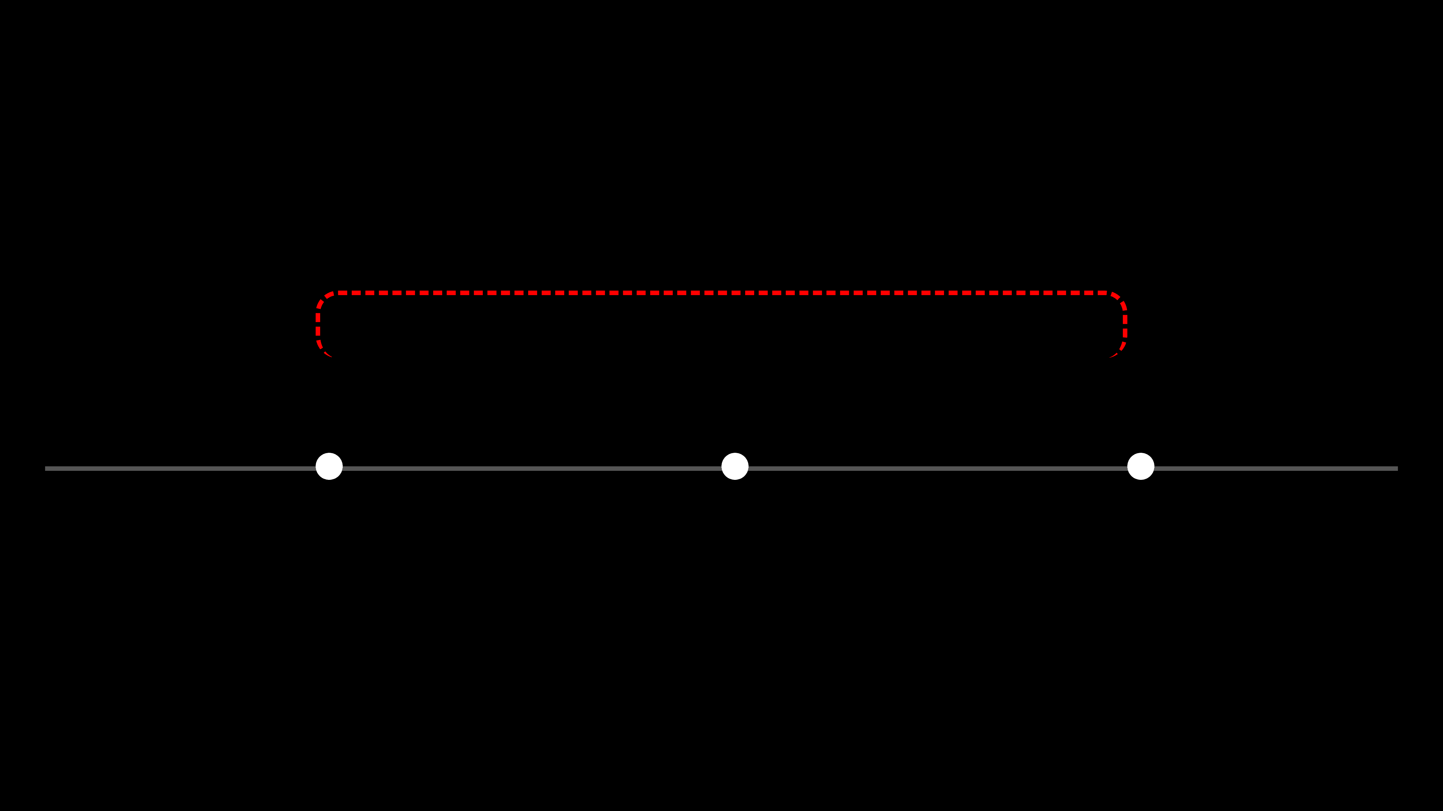
CV Pitfalls
Don't predict the past with the future.
The Time Traveler Problem
LEAKAGE!
Standard Cross-Validation shuffles data. If your data has a time component (e.g., Stock Prices), shuffling is dangerous.
Jan (Train)
Feb (Test)
Mar (Train)
⚠ The Mistake:
Using data from March to predict February.
In the real world, you can't see the future. Your model will fail in production.
Solution: Use TimeSeriesSplit (Forward Chaining).

Slide 25
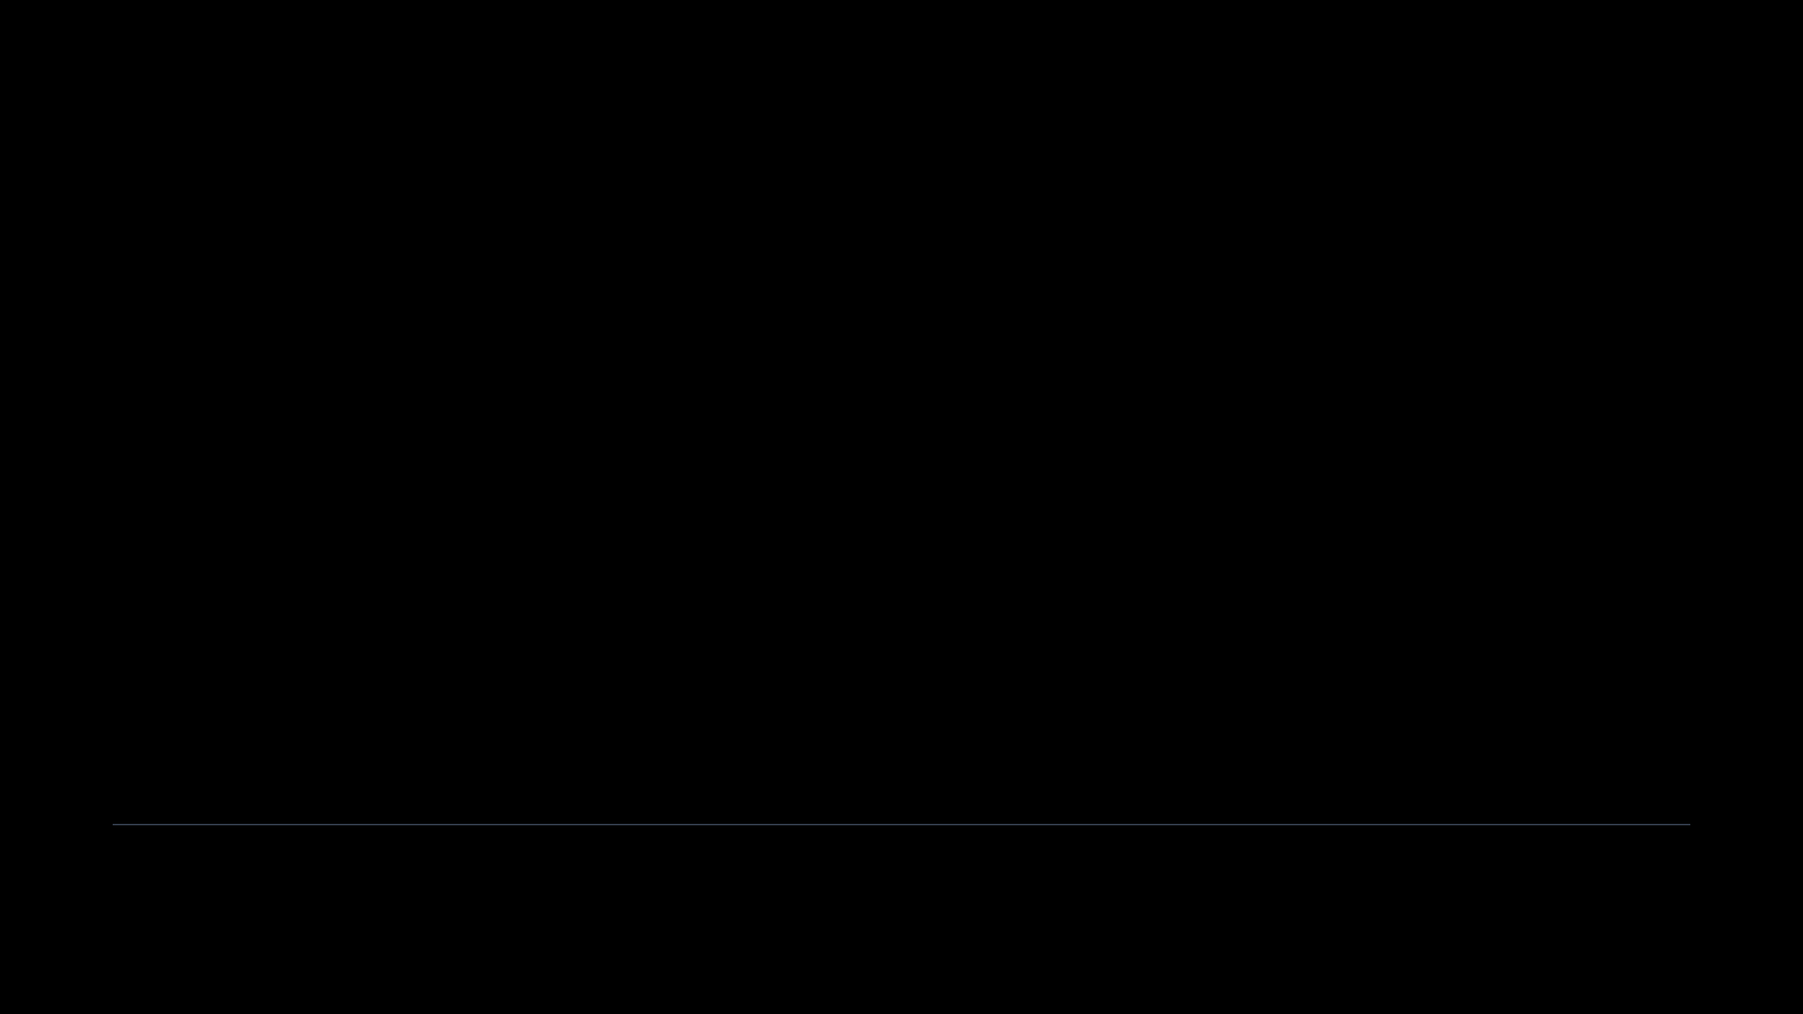
When NOT to use CV?
Sometimes simple is better.
1. Massive Datasets
If you have 100 million rows, a single 80/20 split is statistically stable enough. CV is overkill and too slow.
2. Deep Learning
Training a neural network might take 3 days. Doing that 5 times (5-Fold CV) takes 2 weeks. Usually not feasible.
3. Streaming Data
If data changes every second (Concept Drift), a static CV score from yesterday is meaningless today.
Rule of Thumb:
Use CV for Small to Medium datasets (e.g., < 1M rows).

Slide 26
The Full Workflow
Putting it all together.
1. Split Data
2. Cross-Validation
80% Train / 20% Test
Tune & Experiment
Lock Test set
Use Training Set only
3. Final Training
4. Final Test
Retrain on ALL Train Data
Unlock the Vault
Train on full 80%
Evaluate once on 20% Test

Slide 27
Reporting Results
Don't just give me a number.
The Amateur Way
APPROVED
Model Performance Report
"My model has 92% accuracy."
Baseline (Majority Class):
65.0%
(Is that good? Is it stable? What about false alarms?)
Model Accuracy (CV):
92.0% ± 1.5%
The Pro Way
Precision (Fraud):
88.5%
1. Report the
Baseline
(Guessing).
Recall (Fraud):
95.0%
2. Report the
Variance
(±).
3. Report the
Business Metric
(Recall/Precision).
*Optimized for Recall to minimize missed fraud cases.

Slide 28
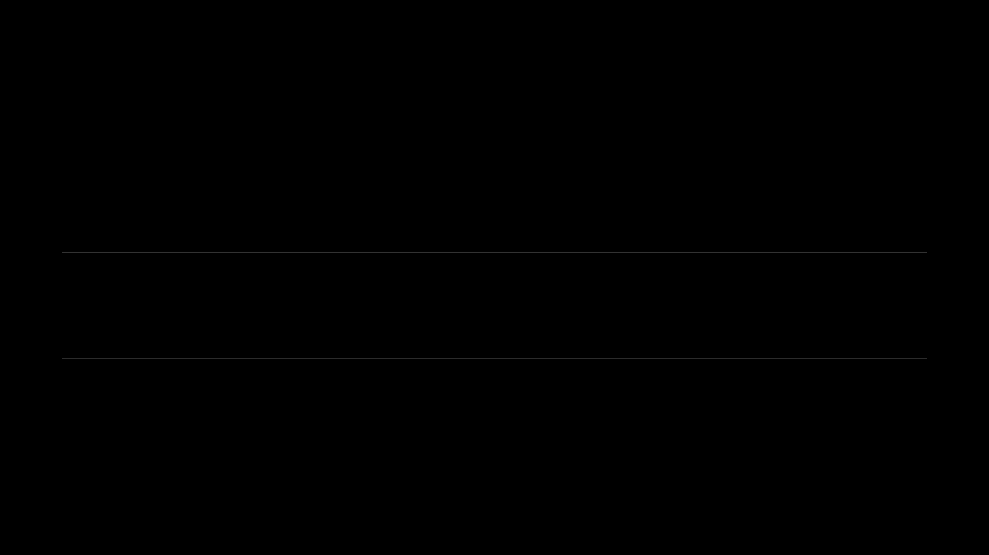
Common Pitfalls
How to fail.
⚖️
The Accuracy Trap
Celebrating 99% accuracy on a dataset with 99% negative cases. Your model learned nothing.
⏳
Data Leakage
Using future data to predict the past, or normalizing the entire dataset before splitting.
📉
Ignoring the Baseline
"My model has 60% accuracy!" (But a random coin flip gets 50%... so you barely improved anything).

Slide 29
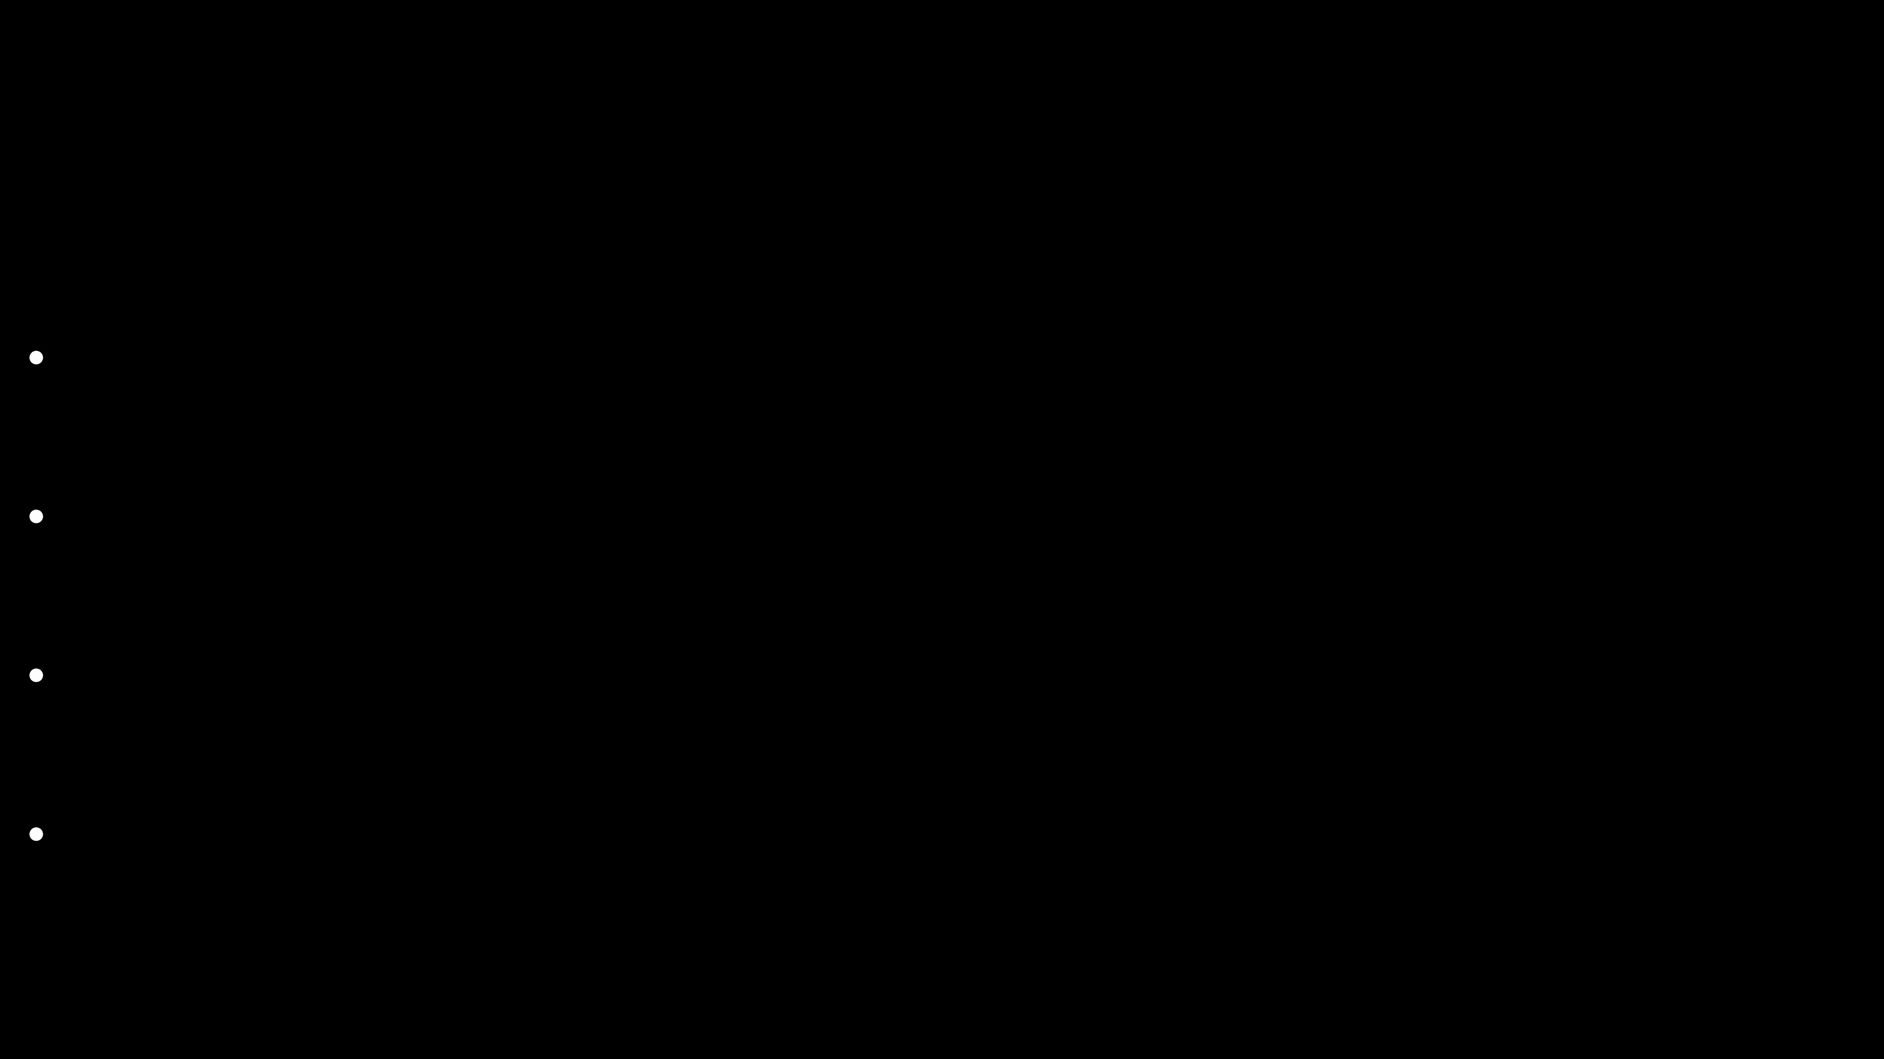
Key Takeaways
What to remember.
1.
Accuracy is dangerous
on imbalanced data. Use Precision/Recall instead.
2.
Cross-Validation
is mandatory. Don't trust a single lucky split.
3.
Understand the
Tradeoff
. You can't have perfect Precision and Recall.
4.
Always beat the
Baseline
. If you can't beat a coin flip, go back to the drawing board.

Slide 30
Lab Preview
Module 07 Lab: Model Evaluation
In this lab, we will go beyond simple accuracy using the Titanic dataset.
💻
Train a Logistic Regression model.
📊
Generate a Confusion Matrix.
📈
Plot the ROC Curve & Calculate AUC.
🔄
Implement Cross-Validation from scratch.
"You will see exactly why Accuracy is misleading for the Titanic survival prediction."

